Slide 1
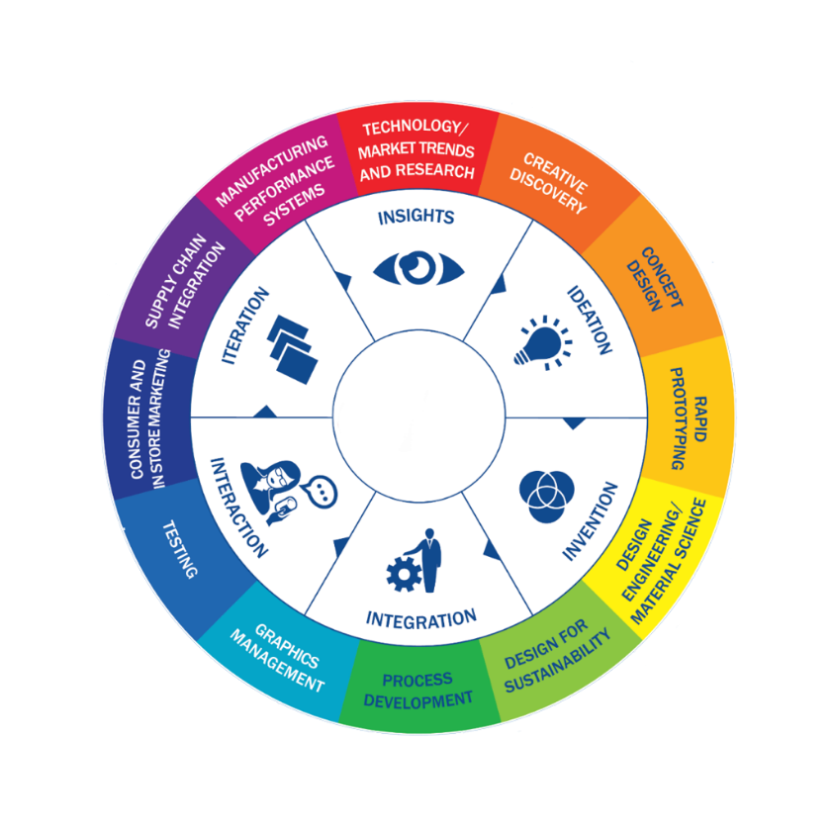

MSC3182
SOCIAL ENTREPRENEURSHIP
Lesson 4
BUSINESS MODEL & LEAN APPROACH

Slide 2

BUSINESS IDEA
A concept that can be used for financial gain that is usually centered on a product or service that can be offered for money.
An idea is the base of the pyramid when it comes to the business as a whole.
The characteristics of a promising business idea are:
Innovative
Unique
Problem solving
Profitable
A business idea is often linked to its creator who needs to identify the business' value proposition in order to launch to market and establish competitive advantage.

Slide 3
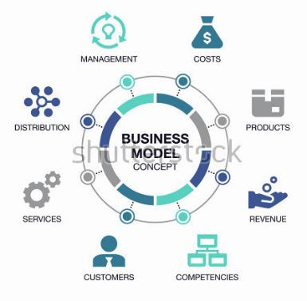
BUSINESS MODEL
A plan for
the successful operation of a business,
identifying sources of revenue,
the intended customer base,
products, and
details of financing.

Slide 4
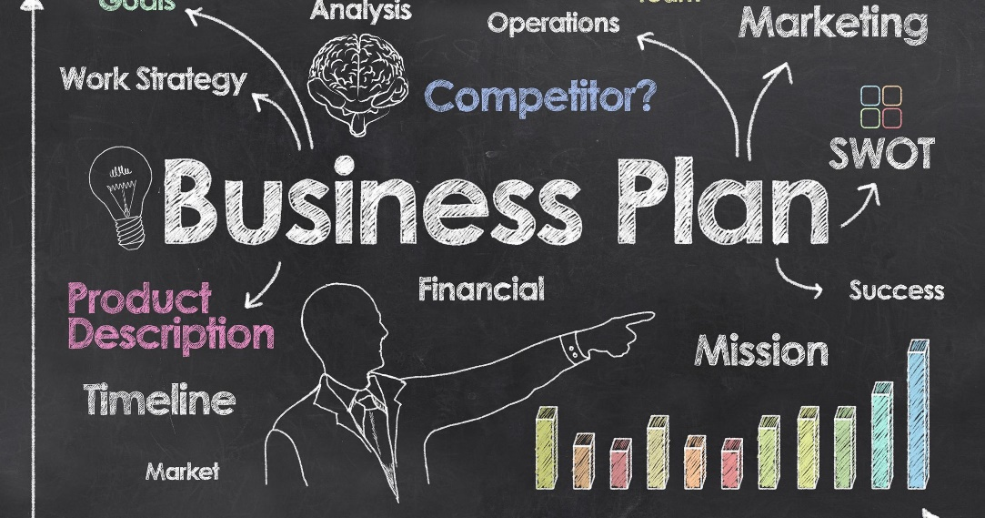
BUSINESS PLAN
A business plan is a formal statement of business goals, reasons they are attainable, and plans for reaching them.
It may also contain background information about the organization or team attempting to reach those goals.
Written business plans are often required to obtain a bank loan or other financing.

Slide 5
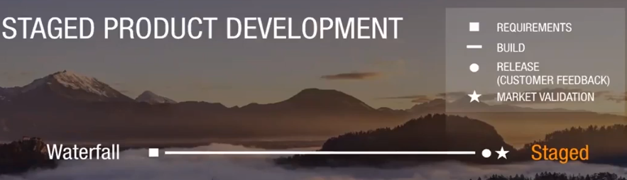
LEAN APPROACH
1950 – Lean Manufacturing - provides tools and processes to eliminate waste from the manufacturing process resulting in improved efficiency, effectiveness, and profitability.
1970 – Staged product Development (water fall like approach)

Slide 6
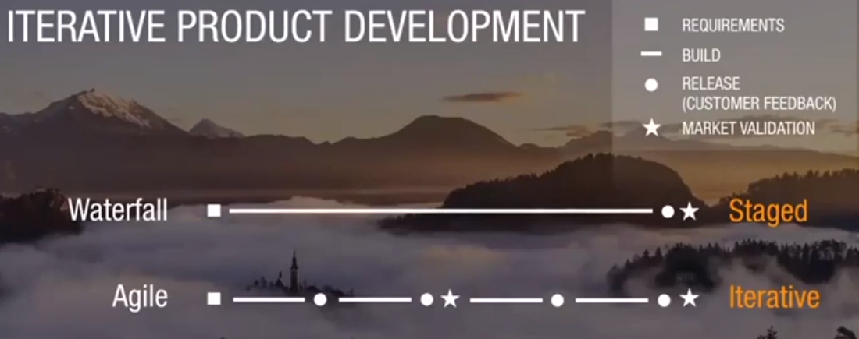
LEAN APPROACH
1990 – 2000 – Agile (Iterative Product development)

Slide 7
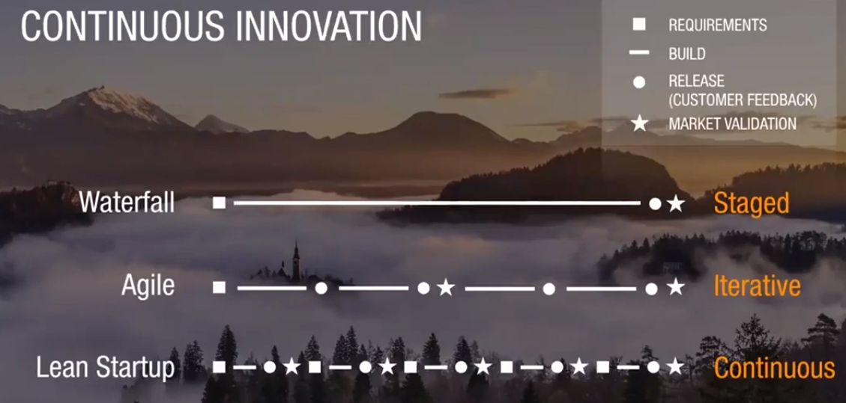
LEAN APPROACH
2010 – Lean Startup

Slide 8
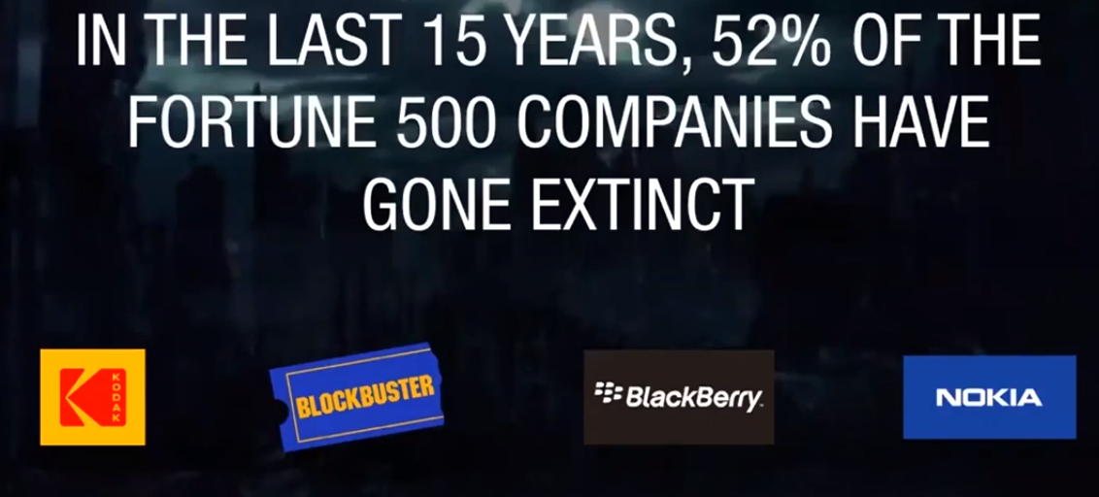
LEAN APPROACH

Slide 9
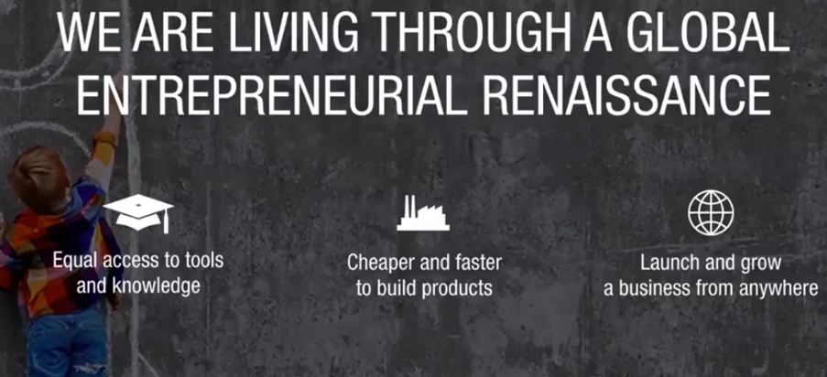
LEAN APPROACH

Slide 10

LEAN APPROACH

Slide 11
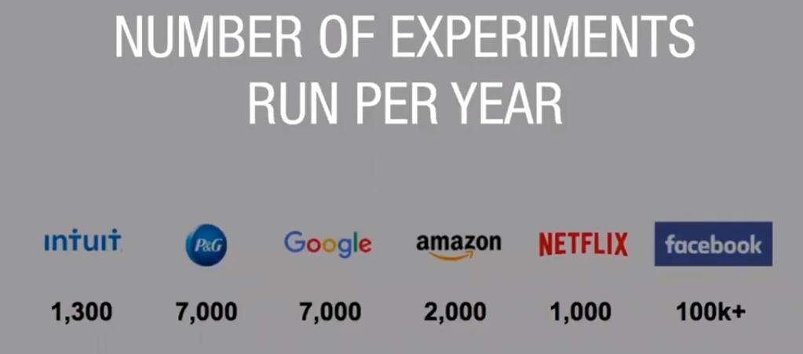
LEAN APPROACH

Slide 12
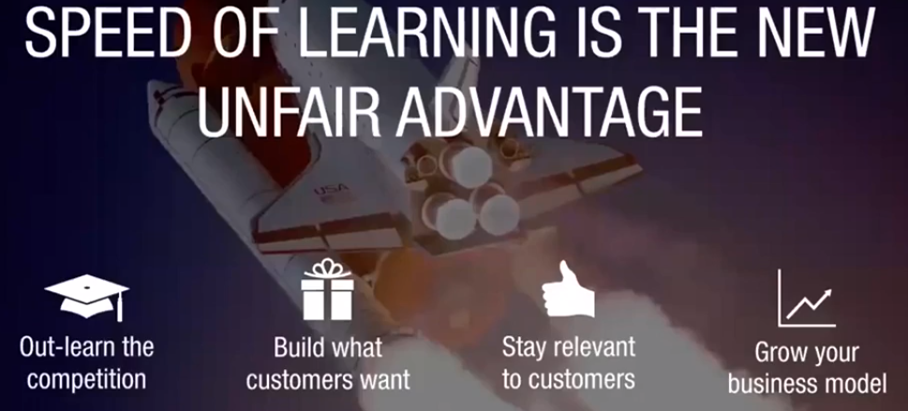
LEAN APPROACH

Slide 13
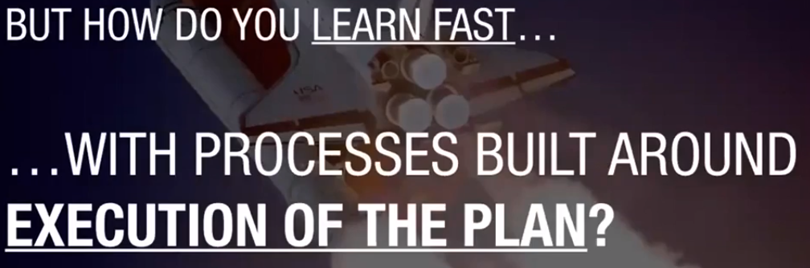
LEAN APPROACH

Slide 14

LEAN APPROACH

Slide 15


LEAN APPROACH

Slide 16
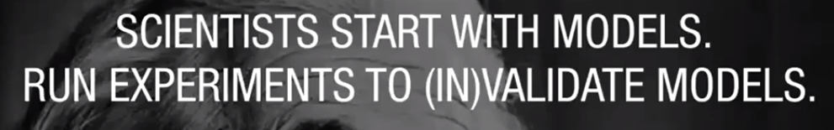
LEAN APPROACH

Slide 17
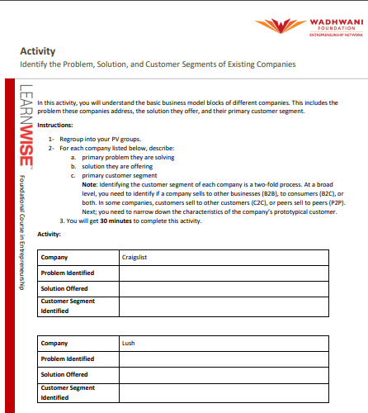
LEAN APPROACH

